Slide 1
Unit 6 : Data Mining Approaches and Methods

Slide 2
Types of Data Mining Models
Predictive Model
(a)Classification -Data is mapped into predefined groups or classes. Also termed as supervised learning as classes are established prior to examination of data.
(b) Regression- Mapping of data item into known type of functions. These may be linear, logistic functions etc.
(c) Time Series Analysis- Value of an attribute are examined at evenly spaced times, as it varies with time.
(d) Prediction- It means fore telling future data states based on past and current data.

Slide 3
Types of Data Mining Models
Descriptive Models
(a) Clustering- It is referred as unsupervised learning or segmentation/partitioning. In clustering groups are not pre-defined.
(b) Summarization- Data is mapped into subsets with simple descriptions . Also termed as Characterization or generalization.
(c) Sequence Discovery- Sequential analysis or sequence discovery utilized to find out sequential patterns in data. Similar to association but relationship is based on time.
(d) Association Rules- A model which identifies specific types of data associations.

Slide 4
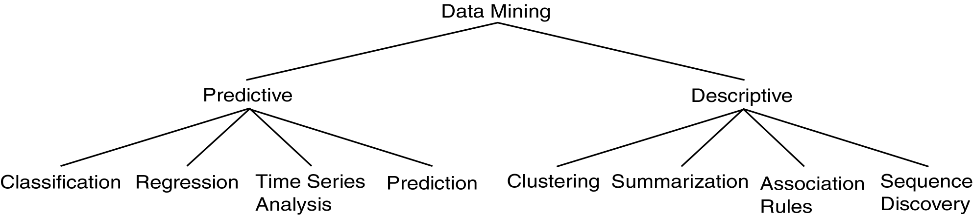
Descriptive vs. Predictive Data Mining
Descriptive Mining:
It describes concepts or task-relevant data sets in concise, summarative, informative, discriminative forms.
Predictive Mining:
It is based on data and analysis, constructs models for the database, and predicts the trend and properties of unknown data.

Slide 5
Supervised and Unsupervised learning
Supervised learning:
The network answer to each input pattern is directly compared with the desired answer and a feedback is given to the network to correct possible errors
Unsupervised learning:
The target answer is unknown. The network groups the input patterns of the training sets into clusters, based on correlation and similarities.

Slide 6
Supervised
Bayesian Modeling
Decision Trees
Neural Networks
Unsupervised
One-way Clustering
Two-way Clustering
Type and number of classes are known in advance
Type and number of classes are NOT known in advance

Slide 7
Classification and Prediction
Classification and prediction are two forms of data analysis that can be used to extract models describing important data classes or to predict future data trends. Such analysis can help provide us with a better understanding of the data at large.
Whereas classification predicts categorical (discrete, unordered) labels, prediction models continuous valued functions.
For example, we can build a classification model to categorize bank loan applications as either safe or risky, or a prediction model to predict the expenditures in dollars of potential customers on computer equipment given their income and occupation.

Slide 8
Prediction
Prediction is viewed as the construction and use of a model to assess the class of an unlabeled sample or to assess the value ranges of an attribute that a given sample is likely to have.
It is a statement or claim that a particular event will occur in the future in more certain terms than a forecast . It is similar to classification. It constructs a model to predict unknown or missing values. Prediction is the most prevalent grade level expectation on reasoning in state mathematics standards.

Slide 9
Generally it predicts a continuous value rather than categorical label. Numeric prediction predicts the continuous value. The most widely used approach for numeric prediction is regression.
Regression analysis is used to model the relationship between one or more independent or predictor variables and a dependent or response variable. In the context of Data Mining, predictor variables are attributes of interest describing the tuple.

Slide 10
Linear Regression
Regression is a statistical methodology developed by Sir Frances Galton in 1822-1911. Straight line regression analysis involves a response variable y and a single predictor variable x.
The simplest form of regression is
y = a + bx
Where y is response variable and x is single predictor variable y is a linear function of x. a and b are regression coefficients.
As the regression coefficients are also considered as weights, we may write the above equation as:
y = w+w1x
These coefficients are solved by the method of least squares, which estimates the best fitting straight line as the one that minimizes the error between the actual data and the estimate of the line.

Slide 11
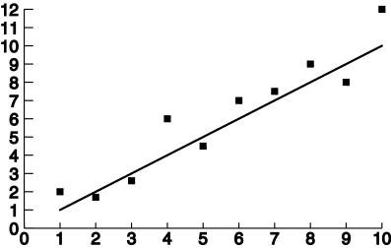
Linear Regression

Slide 12
Classification is the process of finding a model (or function) that describes and distinguishes data classes or concepts, for the purpose of being able to use the model to predict the class of objects whose class label is unknown. The derived model is based on the analysis of a set of training data (i.e., data objects whose class label is known).
“How is the derived model presented?” The derived model may be represented in various forms, such as classification (IF-THEN) rules, decision trees, mathematical formulae, or neural networks.

Slide 13
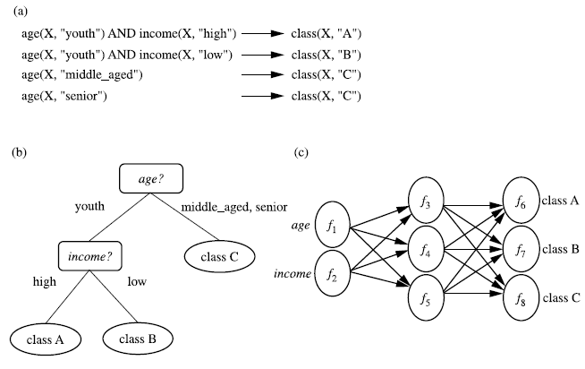
Figure : A classification model can be represented in various forms, such as (a) IF-THEN rules, (b) a decision tree, or a (c) neural network.

Slide 14
Classification : Example of Grading
x
<90
>=90
If x >= 90 then grade =A.
If 80<=x<90 then grade =B.
If 70<=x<80 then grade =C.
If 60<=x<70 then grade =D.
If x<50 then grade =F.
x
A
<80
>=80
x
B
<70
>=70
x
C
<50
>=60
F
D

Slide 15
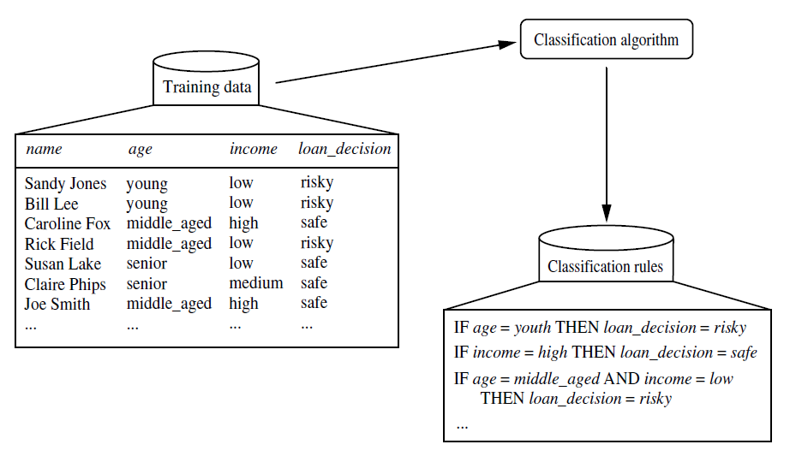
Figure: Learning
Here, the class label attribute is loan decision, and the learned model or classifier is represented in the form of classification rules.

Slide 16
Examples of Classification Algorithms
Decision Trees
Neural Networks
Bayesian Networks

Slide 17
Decision Trees
A decision tree is a predictive model that as its name implies can be viewed as a tree. Specifically each branch of the tree is a classification question and the leaves are partitions of data set with their classification.
A decision tree makes a prediction on the basis of a series of decisions. The decision trees are being built on historical data and are a part of the supervised learning. The machine learning technique for inducting a decision tree from data is called decision tree learning.
Internal node denotes a test on an attribute
Branch represents an outcome of the test
Leaf nodes represent class labels or class distribution

Slide 18
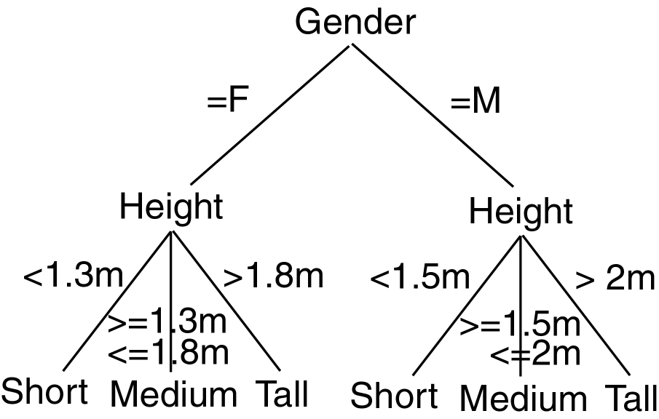
Decision Tree Example

Slide 19
Decision Tree: Example
Day Outlook Temperature Humidity Wind Play Tennis
1 Sunny Hot High Weak No
2 Sunny Hot High Strong No
3 Overcast Hot High Weak Yes
4 Rain Mild High Weak Yes
5 Rain Cool Normal Weak Yes
6 Rain Cool Normal Strong No
7 Overcast Cool Normal Strong Yes
8 Sunny Mild High Weak No
9 Sunny Cool Normal Weak Yes
10 Rain Mild Normal Weak Yes
11 Sunny Mild Normal Strong Yes
12 Overcast Mild High Strong Yes
13 Overcast Hot Normal Weak Yes
14 Rain Mild High Strong No
Outlook
Sunny
Rain
Overcast
Humidity
Yes
Wind
High
Normal
Strong
Weak
No
Yes
No
Yes
Attributes = {Outlook, Temperature, Humidity, Wind}
Play Tennis = {yes, no}

Slide 20
Decision Tree Learning Algorithm - ID3
ID3 (Iterative Dichotomiser) is a simple decision tree learning algorithm developed by Ross Quinlan (1983). ID3 follow non-backtracking approach in which decision trees are constructed in a top-down recursive “divide and conquer” manner to test each attribute at every tree node. This approach starts with a training set of tuples and their associated class labels. Training set is recursively partitioned into smaller subsets as the tree is being built.

Slide 21
Pros and Cons of Decision Tree
Pros
no distributional assumptions
can handle real and nominal inputs
speed and scalability
robustness to outliers and missing values
interpretability
compactness of classification rules
They are easy to use.
Generated rules are easy to understand .
Amenable to scaling and the database size.
Cons
several tuning parameters to set with little guidance
decision boundary is non-continuous
Cannot handle continuous data.
Incapable of handling many problems which cannot be divided into attribute domains.
Can lead to over-fitting as the trees are constructed from training data.

Slide 22
Bayesian Classification
Bayesian classifiers are statistical classifiers.
They can predict class membership probabilities, such as the probability that a given tuple belongs to a particular class.
Bayesian classification is based on Bayes’ theorem.
Bayesian classifiers have also exhibited high accuracy and speed when applied to large databases.

Slide 23

Bayes’ Theorem
P(H|X) is the posterior probability
P(X|H) is the posterior probability of X conditioned on H.
P(H) is the prior probability, or a priori probability, of H.
P(X) is the prior probability of X.

Slide 24

Naïve Bayesian Classification
P(X) is constant for all classes, only P(X|Ci)P(Ci) need be maximized.

Slide 25
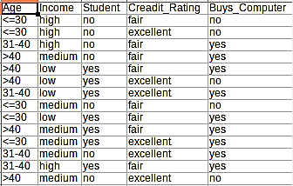
Example

Slide 26
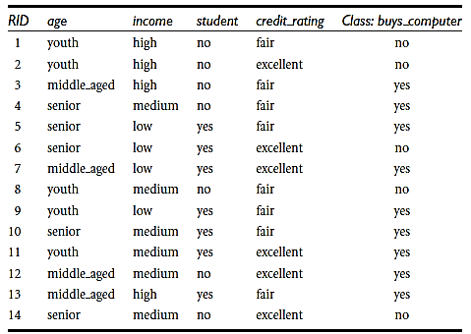

Slide 27
The data tuples are described by the attributes age, income, student, and credit rating.
The class label attribute, buys computer, has two distinct values (namely, {yes, no}).
Let C1 correspond to the class buys computer = yes and C2 correspond to buys computer = no.
The tuple we wish to classify is
X = (age = youth, income = medium, student = yes, credit rating = fair)
We need to maximize P(X|Ci)P(Ci), for i = 1, 2.
P(Ci), the prior probability of each class, can be computed based on the training tuples:
P(buys computer = yes) = 9/14 = 0.643
P(buys computer = no) = 5/14 = 0.357

Slide 28
To compute P(X|Ci), for i = 1, 2, we compute the following conditional probabilities:
P(age = youth | buys computer = yes) = 2/9 = 0.222
P(age = youth | buys computer = no) = 3/5 = 0.600
P(income = medium | buys computer = yes) = 4/9 = 0.444
P(income = medium | buys computer = no) = 2/5 = 0.400
P(student = yes | buys computer = yes) = 6/9 = 0.667
P(student = yes | buys computer = no) = 1/5 = 0.200
P(credit rating = fair | buys computer = yes) = 6/9 = 0.667
P(credit rating = fair | buys computer = no) = 2/5 = 0.400

Slide 29
Using the above probabilities, we obtain
P(X|buys computer = yes) = P(age = youth | buys computer = yes) X P(income = medium | buys computer = yes) X P(student = yes | buys computer = yes) X P(credit rating = fair | buys computer = yes)
= 0.222 x 0.444 x 0.667 x 0.667
= 0.044.
Similarly,
P(X|buys computer = no)
= 0.600 x 0.400 x 0.200 x 0.400 = 0.019.

Slide 30
To find the class, Ci, that maximizes P(X|Ci)P(Ci), we compute
P(X|buys computer = yes) X P(buys computer = yes)
= 0.044 x 0.643
= 0.028
P(X|buys computer = no) X P(buys computer = no)
= 0.019 x 0.357
= 0.007
Therefore, the naïve Bayesian classifier predicts “buys_computer = yes” for tuple X.

Slide 31
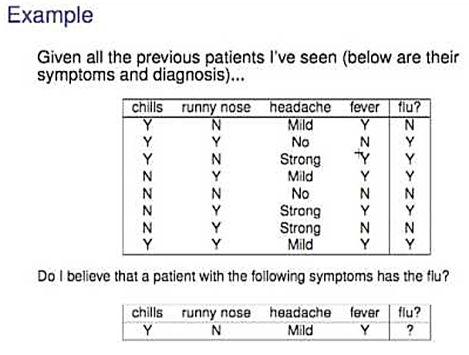

Slide 32
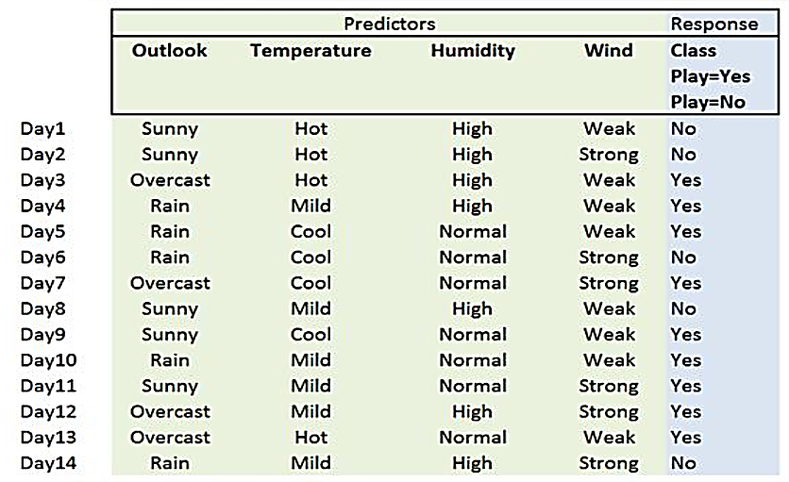


Slide 33
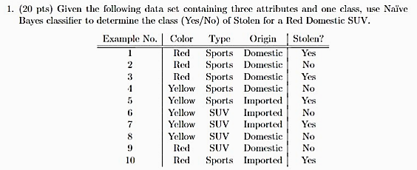

Slide 34
Neural Networks
Neural Network is a set of connected INPUT/OUTPUT UNITS, where each connection has a WEIGHT associated with it. It is a case of SUPERVISED, INDUCTIVE or CLASSIFICATION learning.
Neural Network learns by adjusting the weights so as to be able to correctly classify the training data and hence, after testing phase, to classify unknown data. Neural Network needs long time for training. Neural Network has a high tolerance to noisy and incomplete data.

Slide 35
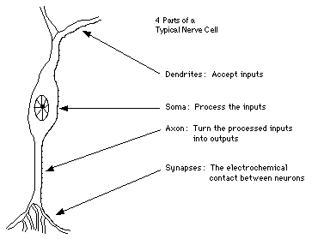
Similarity with Biological Network
Fundamental processing element of a neural network is a neuron
A human brain has 100 billion neurons
An ant brain has 250,000 neurons

Slide 36
A Neuron (= a Perceptron)
-
μ_{k}
x₀
w₀
x₁
w₁
∑
f
output y
x_{n}
w_{n}
Input
vector x
weight
vector w
weighted
sum
Activation
function
The n-dimensional input vector x is mapped into variable y by means of the scalar product and a nonlinear function mapping

Slide 37
Perceptron
y1
y2
yp-1
yp
...
1
2
p-1
p
wp-1,1
w1,1
w1,n
wp,1
...
...
...
w2,1
w1,2
w1,n-1
wp,n
...
x1
x2
xn-1
xn

Slide 38
Multi-Layer Perceptron
Output vector
Output nodes
Hidden nodes
w_{ij}
Input nodes
Input vector: x_{i}

Slide 39
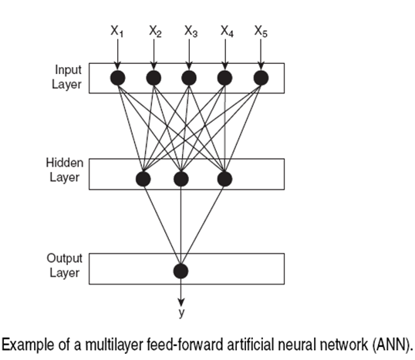

Slide 40
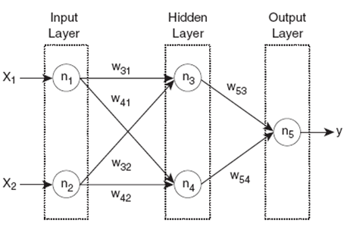


Slide 41
Advantages of Neural Network
prediction accuracy is generally high
robust, works when training examples contain errors
output may be discrete, real-valued, or a vector of several discrete or real-valued attributes
fast evaluation of the learned target function
High tolerance to noisy data
Ability to classify untrained patterns
Well-suited for continuous-valued inputs and outputs
Successful on a wide array of real-world data
Algorithms are inherently parallel
Techniques have recently been developed for the extraction of rules from trained neural networks

Slide 42
Disadvantages of Neural Network
long training time
difficult to understand the learned function (weights)
not easy to incorporate domain knowledge
Require a number of parameters typically best determined empirically, e.g., the network topology or ``structure."
Poor interpretability: Difficult to interpret the symbolic meaning behind the learned weights and of ``hidden units" in the network

Slide 43
Association Rule
Proposed by Agrawal et al in 1993.
It is an important data mining model studied extensively by the database and data mining community.
Assume all data are categorical.
No good algorithm for numeric data.
Initially used for Market Basket Analysis to find how items purchased by customers are related.
Given a set of records each of which contain some number of items from a given collection;
Produce dependency rules which will predict occurrence of an item based on occurrences of other items.
Rules Discovered:
{Milk} --> {Coke}
{Diaper, Milk} --> {Beer}

Slide 44
Applications:
Basket data analysis, cross-marketing, catalog design, loss-leader analysis, clustering, classification, etc.
E.g., 98% of people who purchase tires and auto accessories also get automotive services done
Concepts:
An item: an item/article in a basket
I: the set of all items sold in the store
A transaction: items purchased in a basket; it may have TID (transaction ID)
A transactional dataset: A set of transactions
The model: rules
A transaction t contains X, a set of items (itemset) in I, if X ⊆ t.
An association rule is an implication of the form:
X → Y, where X, Y ⊂ I, and X ∩Y = ∅
An itemset is a set of items.
E.g., X = {milk, bread, cereal} is an itemset.
A k-itemset is an itemset with k items.
E.g., {milk, bread, cereal} is a 3-itemset

Slide 45
Rule Strength Measures
Support:
The rule holds with support sup in T (the transaction data set) if sup% of transactions contain X ∪ Y.
sup = Pr(X ∪ Y)
Confidence:
The rule holds in T with confidence conf if conf% of transactions that contain X also contain Y.
conf = Pr(Y | X)
An association rule is a pattern that states when X occurs, Y occurs with certain probability.

Slide 46
Support and Confidence
support of X in D is count(X)/|D|
For an association rule X⇒Y, we can calculate
support (X⇒Y) = support (XY)
confidence (X⇒Y) = support (XY)/support (X)
Relate Support (S) and Confidence (C) to Joint and Conditional probabilities
There could be exponentially many A-rules
Interesting association rules are (for now) those whose S and C are greater than minSup and minConf (some thresholds set by data miners)

Slide 47
Support and Confidence
Support count:
The support count of an itemset X, denoted by X.count, in a data set T is the number of transactions in T that contain X. Assume T has n transactions. Then,

Slide 48
Basic Concepts: Association Rules
Transaction-id | Items bought
10 | A, B, C
20 | A, C
30 | A, D
40 | B, E, F
Itemset X={x₁, …, x_{k}}
Find all the rules X→Y with min confidence and support
support, s, probability that a transaction contains X∪Y
confidence, c, conditional probability that a transaction having X also contains Y.
Customer
buys both
Customer
buys diaper
Let minimum support 50%, and minimum confidence 50%, we have
A → C (50%, 66.7%)
C → A (50%, 100%)
Customer
buys beer

Slide 49
Example
Data set D
Count, Support, Confidence:
Count(13)=2
|D| = 4
Support(13)=0.5
Support(3→2)=0.5
Confidence(3→2)=0.67
TID | Itemsets
T100 | 1 3 4
T200 | 2 3 5
T300 | 1 2 3 5
T400 | 2 5

Slide 50
Mining Association Rules: Example
Min. support 50%
Min. confidence 50%
Transaction-id | Items bought
10 | A, B, C
20 | A, C
30 | A, D
40 | B, E, F
Frequent pattern | Support
{A} | 75%
{B} | 50%
{C} | 50%
{A, C} | 50%
For rule A ⇒ C:
support = support({A}∪{C}) = 50%
confidence = support({A}∪{C})/support({A}) = 66.6%
The Apriori principle:
Any subset of a frequent itemset must be frequent

Slide 51
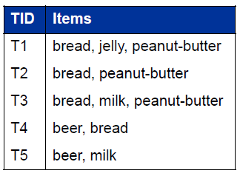
Example of Association Rule
Examples:
bread ⇒ peanut-butter
beer ⇒ bread
Frequent itemsets: Items that frequently appear together
I = {bread, peanut-butter}
I = {beer, bread}

Slide 52
Support count (σ): Frequency of occurrence of and itemset
σ ({bread, peanut-butter}) = 3
σ ({ beer, bread}) = 1
Support: Fraction of transactions that contain an itemset
s ({bread,peanut-butter}) = 3/5
s ({beer, bread}) = 1/5
Frequent itemset: An itemset whose support is greater than or equal to a minimum support threshold (minsup)

Slide 53


What’s an Interesting Rule?
An association rule is an implication of two itemsets:
X ⇒ Y
Many measures of interest. The two most used are:
Support (s): The occurring frequency of the rule, i.e., number of transactions that contain both X and Y
Confidence (c): The strength of the association, i e measures of how often items (X)

Slide 54
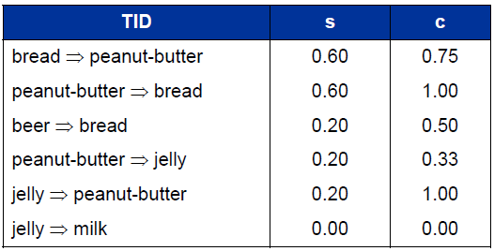

Slide 55
The Apriori Algorithm—An Example
Database TDB
1-candidates
Freq 1-itemsets
C₁
Itemset | sup
{A} | 2
{B} | 3
{C} | 3
{D} | 1
{E} | 3
Tid | Items
10 | A, C, D
20 | B, C, E
30 | A, B, C, E
40 | B, E
L₁
Itemset | sup
{A} | 2
{B} | 3
{C} | 3
{E} | 3
1st scan
Min_sup=2
Frequency ≥ 50%, Confidence 100%:
A → C
B → E
BC → E
CE → B
BE → C
Freq 2-itemsets
Counting
2-candidates
L₂
Itemset | sup
{A, C} | 2
{B, C} | 2
{B, E} | 3
{C, E} | 2
C₂
Itemset | sup
{A, B} | 1
{A, C} | 2
{A, E} | 1
{B, C} | 2
{B, E} | 3
{C, E} | 2
C₂
Itemset
{A, B}
{A, C}
{A, E}
{B, C}
{B, E}
{C, E}
2nd scan
3-candidates
Freq 3-itemsets
Itemset
{B, C, E}
3rd scan
L₃
Itemset | sup
{B, C, E} | 2
C₃

Slide 56
Clustering and Cluster Analysis
A cluster is a collection of objects which are “similar” between them and are “dissimilar” to the objects belonging to other clusters.
Clustering is “the process of organizing objects into groups whose members are similar in some way”.
“Cluster Analysis is a set of methods for constructing a (hopefully) sensible and informative classification of an initially unclassified set of data, using the variable values observed on each individual.”
- B. S. Everitt (1998), “The Cambridge Dictionary of Statistics”

Slide 57
Applications of Cluster Analysis
Pattern Recognition
Spatial Data Analysis
Create thematic maps in GIS by clustering feature spaces
Detect spatial clusters or for other spatial mining tasks
Image Processing
Economic Science (especially market research)
WWW
Document classification
Cluster Weblog data to discover groups of similar access patterns

Slide 58
Applications of Cluster Analysis
Marketing: Help marketers discover distinct groups in their customer bases, and then use this knowledge to develop targeted marketing programs
Land use: Identification of areas of similar land use in an earth observation database
Insurance: Identifying groups of motor insurance policy holders with a high average claim cost
City-planning: Identifying groups of houses according to their house type, value, and geographical location
Earth-quake studies: Observed earth quake epicenters should be clustered along continent faults

Slide 59
Objectives of Cluster Analysis
Finding groups of objects such that the objects in a group will be similar (or related) to one another and different from (or unrelated to) the objects in other groups
Competing objectives
Intra-cluster distances are minimized
Inter-cluster distances are maximized

Slide 60
Types of Clusterings
Partitioning Clustering
A division data objects into non-overlapping subsets (clusters) such that each data object is in exactly one subset
Construct various partitions and then evaluate them by some criterion, e.g., minimizing the sum of square errors
Typical methods: k-means, k-medoids, CLARA (Clustering LARge Applications)
Hierarchical clustering
A set of nested clusters organized as a hierarchical tree
Create a hierarchical decomposition of the set of data (or objects) using some criterion
Typical methods: DiAna (Divisive Analysis), AgNes (Agglomerative Nesting), BIRCH (Balanced Iterative Reducing and Clustering using Hierarchies), ROCK (RObust Clustering using linKs), CAMELEON
Density-based Clustering
Based on connectivity and density functions
Typical methods: DBSACN (Density Based Spatial Clustering of Applications with Noise), OPTICS (Ordering Points To Identify the Clustering Structure), DenClue (DENsity-based CLUstEring )

Slide 61
Grid-based Clustering
based on a multiple-level granularity structure
Typical methods: STING (STatistical INformation Grid ), WaveCluster, CLIQUE (Clustering In QUEst)
Model-based Clustering
A model is hypothesized for each of the clusters and tries to find the best fit of that model to each other
Typical methods: EM (Expectation Maximization), SOM (Self-Organizing Map), COBWEB
Frequent pattern-based Clustering
Based on the analysis of frequent patterns
Typical methods: pCluster
User-guided or constraint-based Clustering
Clustering by considering user-specified or application-specific constraints
Typical methods: COD, constrained clustering

Slide 62
Partitioning Clustering
Original Points
A Partitional Clustering

Slide 63
Hierarchical Clustering
Dendrogram 1
Dendrogram 2

Slide 64
Strengths of Hierarchical Clustering
Do not have to assume any particular number of clusters
Any desired number of clusters can be obtained by ‘cutting’ the dendogram at the proper level
They may correspond to meaningful taxonomies
Example in biological sciences (e.g., animal kingdom, phylogeny reconstruction, …)

Slide 65
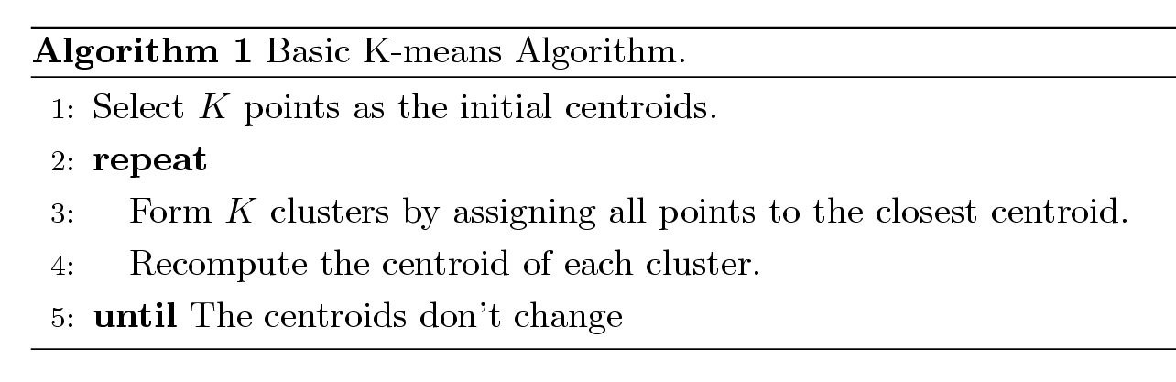
K-means Algorithm
Partitioning clustering approach
Each cluster is associated with a centroid (center point or mean point)
Each point is assigned to the cluster with the closest centroid
Number of clusters, K, must be specified
The basic algorithm is very simple:

Slide 66
The k-means partitioning algorithm.
Algorithm: k-means. The k-means algorithm for partitioning, where each cluster’s center is represented by the mean value of the objects in the cluster.
Input:
k: the number of clusters,
D: a data set containing n objects.
Output: A set of k clusters.
Method:
(1) arbitrarily choose k objects from D as the initial cluster centers;
(2) repeat
(3) (re)assign each object to the cluster to which the object is the most similar, based on the mean value of the objects in the cluster;
(4) update the cluster means, i.e., calculate the mean value of the objects for each cluster;
(5) until no change;

Slide 67
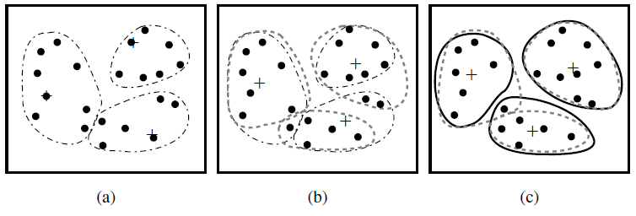
Figure: Clustering of a set of objects based on the k-means method. (The mean of each cluster is marked by a “+”.)

Slide 68
Example
10
10
9
9
8
8
7
7
6
6
5
5
4
Assign each objects to most similar center
Update the cluster means
4
3
3
2
2
1
1
0
0
0
1
2
3
4
5
6
7
8
9
10
0
1
2
3
4
5
6
7
8
9
10
reassign
reassign
K=2
Arbitrarily choose K object as initial cluster center
Update the cluster means

Slide 69
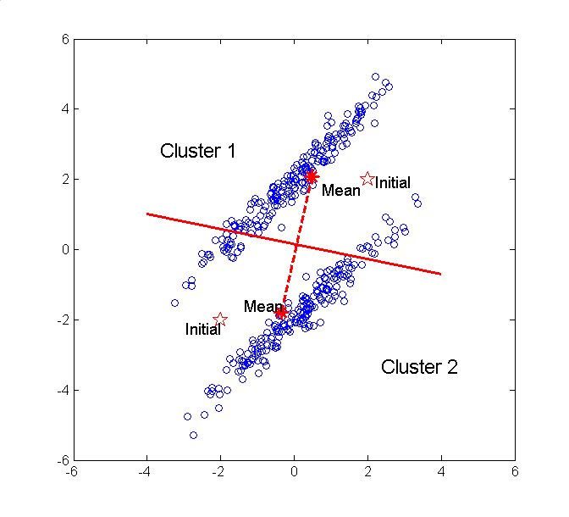

Slide 70
K-means Clustering – Details
Initial centroids are often chosen randomly.
Clusters produced vary from one run to another.
The centroid is (typically) the mean of the points in the cluster.
‘Closeness’ is measured mostly by Euclidean distance, cosine similarity, correlation, etc.
K-means will converge for common similarity measures mentioned above.
Most of the convergence happens in the first few iterations.
Often the stopping condition is changed to ‘Until relatively few points change clusters’
Complexity is O( n * K * I * d )
n = number of points, K = number of clusters, I = number of iterations, d = number of attributes
Typical choice

Slide 71
Issues and Limitations for K-means
How to choose initial centers?
How to choose K?
How to handle Outliers?
Clusters different in
Shape
Density
Size
Assumes clusters are spherical in vector space
Sensitive to coordinate changes

Slide 72
K-means Algorithm
Pros
Simple
Fast for low dimensional data
It can find pure sub clusters if large number of clusters is specified
Cons
K-Means cannot handle non-globular data of different sizes and densities
K-Means will not identify outliers
K-Means is restricted to data which has the notion of a center (centroid)
Applicable only when mean is defined, then what about categorical data?
Need to specify k, the number of clusters, in advance
Unable to handle noisy data and outliers
Not suitable to discover clusters with non-convex shapes

Slide 73
Outliers
What are outliers?
The set of objects are considerably dissimilar from the remainder of the data
Example: Sports: Michael Jordon, Randy Orton, Sachin Tendulkar ...
Applications:
Credit card fraud detection
Telecom fraud detection
Customer segmentation
Medical analysis
Outlier detection and analysis are very useful for fraud detection, etc. and can be performed by statistical, distance-based or deviation-based approaches

Slide 74
How to handle Outliers?
The k-means algorithm is sensitive to outliers !
Since an object with an extremely large value may substantially distort the distribution of the data.
K-Medoids: Instead of taking the mean value of the object in a cluster as a reference point, medoids can be used, which is the most centrally located object in a cluster.
10
10
9
9
8
8
7
7
6
6
5
5
4
4
3
3
2
2
1
1
0
0
1
2
3
4
5
6
7
8
9
10
0
0
1
2
3
4
5
6
7
8
9
10

Slide 75
Example:
Use in finding Fraudulent usage of credit cards. Outlier Analysis may uncover Fraudulent usage of credit cards by detecting purchases of extremely large amounts for a given account number in comparison to regular charges incurred by the same account. Outlier values may also be detected with respect to the location and type of purchase or the purchase frequency.

Slide 76
A Typical K-Medoids Algorithm (PAM)
Total Cost = 20
10
9
8
Arbitrary choose k object as initial medoids
Assign each remaining object to nearest medoids
7
6
5
4
3
2
1
0
0
1
2
3
4
5
6
7
8
9
10
K=2
Randomly select a nonmedoid object,O_{ramdom}
Do loop
Until no change
Total Cost = 26
10
Compute total cost of swapping
10
Swapping O and O_{ramdom}
If quality is improved.
9
9
8
8
7
7
6
6
5
5
4
4
3
3
2
2
1
1
0
0
1
2
3
4
5
6
7
8
9
10
0
0
1
2
3
4
5
6
7
8
9
10

Slide 77
Example of K-medoids
Given the two medoids that are initially chosen are A and B. Based on the following table and randomly placing items when distances are identical to the two medoids, we obtain the clusters {A, C, D} and {B, E}. The three non-medoids {C, D, E} are examined to see which should be used to replace A or B. We have six costs to determine: TC_{AC} (the cost change by replacing medoid A with medoid C), TC_{AD}, TC_{AE}, TC_{BC}, TC_{BD} and TC_{BE}.
TC_{AC}=C_{AAC}+C_{BAC}+C_{CAC}+C_{DAC}+C_{EAC} = 1 + 0 – 2 – 1 + 0 = -2
Where C_{AAC} = the cost change of object A after replacing medoid A with medoid C

Slide 78
Comparison between K-means and K-medoids
The k-medoids method is more robust than k-means in the presence of noise and outliers because a medoid is less influenced by outliers or other extreme values than a mean. However, its processing is more costly than the k-means method. Both methods require the user to specify k, the number of clusters.

Slide 79
Thank you !!!

